Slide 1
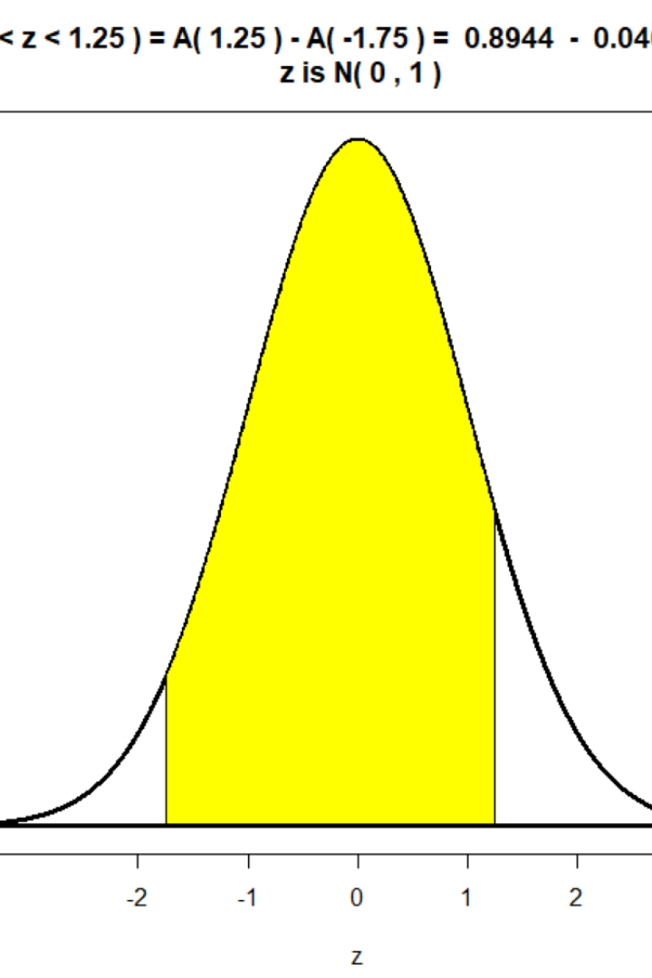
Understanding Normal and Binomial Distribution
Welcome to this presentation on the fascinating world of normal and binomial distribution. Get ready to explore their definitions, characteristics, and real-life applications.
By K INDU

Slide 2

What is Normal Distribution?
1
Definition
2
Characteristics
Normal distribution is a bell-shaped probability distribution that represents a symmetrical pattern of data in various domains.
Normal distributions exhibit shape and symmetry, making them essential for statistical analysis and modeling in numerous fields.
Normal Distribution has bell-shaped curve.

Slide 3
Properties of Normal Distribution
The normal distribution has several key properties:
1
Symmetry
2
Bell-shaped Curve
The normal distribution is symmetric, with the mean, median, and mode all located at the center of the distribution.
The normal distribution exhibits a bell-shaped curve, with the majority of data clustered around the mean.
3
Standard Deviation
4
Empirical Rule
The spread of the data in a normal distribution is determined by the standard deviation.
The empirical rule states that for a normal distribution, approximately 68% of the data falls within one standard deviation, 95% falls within two standard deviations, and 99.7% falls within three standard deviations of the mean.

Slide 4
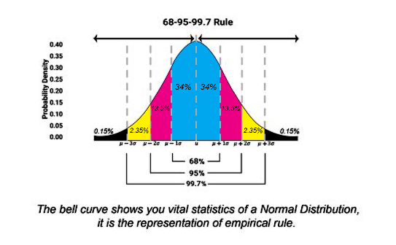
Standard Normal Distribution
Definition
Z-Scores
The standard normal distribution is a specific example of a normal distribution with a mean of 0 and a standard deviation of 1.
Z-scores are used to standardize and compare values within a normal distribution, providing valuable insights in many statistical analyses.
z
Empirical Rule
An image illustrating the Empirical Rule, which states that for a normal distribution, approximately 68% of the data falls within one standard deviation of the mean, 95% falls within two standard deviations, and 99.7% falls within three standard deviations.

Slide 5

Applications of Normal Distribution
1
Finance
In finance, normal distribution helps to model stock prices, investment returns, and risk analysis.
2
Quality Control
Normal distribution is essential for analyzing variations in product quality and setting acceptance criteria.
3
Psychology
Psychological tests or personality assessments often assume normal distribution for accurate interpretation of results.

Slide 6

What is Binomial Distribution
1
Definition
Binomial distribution represents the probability distribution of obtaining a specific number of successes in a fixed number of independent Bernoulli trials.
2
Characteristics
Binomial distribution is discrete, with a mean equal to the product of the number of trials and the probability of success.

Slide 7
Properties of Binomial Distribution
The binomial distribution has the following properties:
1
Fixed Number of Trials
2
Two Possible Outcomes
The binomial distribution is based on a fixed number of independent trials.
Each trial in a binomial distribution has only two possible outcomes: success or failure.
3
Constant Probability
4
Independent Trials
The probability of success remains constant for each trial.
Each trial in a binomial distribution is independent of the others.

Slide 8

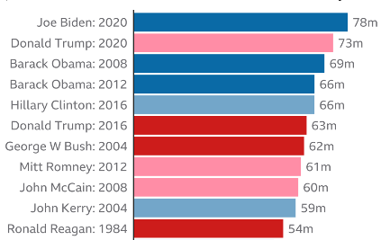

Applications of Binomial Distribution
Marketing Campaigns
Election Predictions
Medical Trials
Binomial distribution helps analyze the success rate of marketing campaigns and the likelihood of customer conversion.
Binomial distribution is utilized in election forecasting to assess the probability of winning for candidates.
In medical research, binomial distribution is employed to evaluate the effectiveness of treatments and measure adverse events.

Slide 9

Conclusion and Summary
Normal Distribution
Key insights: shape, symmetry, standardization with z-scores, applications in finance, quality control, and psychology.
Binomial Distribution
Key insights: fixed number of trials, discrete nature, mean equals number of trials multiplied by probability of success, applications in marketing, elections, and medical research.

